Slide 1

AI: Learning Systems
The Artificial Intelligence Ecosystem

Slide 2

Where we left off
Logic-based systems
ELIZA (1966): Simulated a psychotherapist
SHRDLU (1972): Manipulated objects in a virtual block world
Notes:
Describe the functionalities and limitations of ELIZA and SHRDLU.
Highlight how these systems relied on pre-defined rules and logic.

Slide 3

Document Translation
Georgetown-IBM Experiment (1954):
Translated 60 Russian sentences into English
Challenges in scaling up:
Ambiguity and multiple meanings
Context understanding
Idiomatic expressions
Notes:
One of the early promises of AI was the ability to automatically translate documents from one language to another, a task that proved to be far more complex than anticipated.
Georgetown-IBM Experiment (1954): An early demonstration of machine translation that translated 60 Russian sentences into English. While initially promising, the system used a very limited vocabulary and simple grammar rules.
As researchers attempted to scale up these systems, they encountered significant challenges:
Ambiguity: Human languages are full of ambiguities that are difficult for rule-based systems to handle. Words with multiple meanings and complex sentence structures often led to incorrect translations.
Context Understanding: Effective translation requires understanding the context in which words are used, a capability that early AI systems lacked.
Idiomatic Expressions: Translating idiomatic expressions, which do not have direct equivalents in other languages, proved to be particularly challenging.
The failure to create robust and reliable translation systems led to disillusionment and contributed to the reduction in funding for AI research during the AI Winter.

Slide 4

Language is hard!
“We have already noted that, while we have machine-aided translation of scientific text, we do not have useful machine translation. Further, there is no immediate or predictable prospect of useful machine translation.”
John Pierce, Bell Labs (1964)
Notes:
DARPA's Speech Understanding Research (SUR) Program: An ambitious project aimed at developing a system that could understand and respond to human speech. The program did not achieve its goals within the expected timeline, leading to a loss of confidence and funding cuts. In the ALPAC report, John Pierce recommended funding linguistics research, but believed that translation was better left to humans – at least for now.

Slide 5

The AI Winter
1970s to early 1990s
Reduced funding and interest in AI
Failure of early AI systems to meet expectations
Forced reevaluation of approaches
Notes:
The AI Winter refers to periods in the history of artificial intelligence research characterized by reduced funding and interest due to the failure of AI systems to meet high expectations.
Early optimism about AI's potential led to ambitious projects and promises, many of which proved to be overly optimistic and technologically unfeasible at the time.

Slide 6

The Emergence of Machine Learning
Shift from rule-based to data-driven approaches
Rule-based systems: Fixed rules, limited flexibility
Data-driven systems: Learn from data, adaptive
Introduction of statistical methods and neural networks
Notes:
Fundamental Differences:
Rule-Based Systems: Rely on explicitly programmed rules to make decisions. These systems are inflexible, as they cannot handle situations not anticipated by the rules. They struggle with ambiguity and complexity, often requiring extensive manual updates to remain effective.
Data-Driven Systems: Learn patterns and make decisions based on large datasets. These systems are adaptive and can improve over time as they are exposed to more data. They excel in handling complex and ambiguous scenarios by generalizing from examples.
Shift to Data-Driven Approaches:
Researchers moved towards data-driven approaches as they recognized the limitations of rule-based systems, especially in dealing with real-world variability and complexity. The availability of large datasets and increased computational power also made data-driven methods more feasible and attractive.
Origins of Learning Systems:
The idea for learning systems developed from early work on artificial neural networks and statistical learning. The Perceptron, introduced by Frank Rosenblatt in 1957, was an early example of a machine that could learn from data.
The development of the backpropagation algorithm in 1986 by Rumelhart, Hinton, and Williams was a significant milestone, as it allowed neural networks to learn more effectively by adjusting weights based on errors.

Slide 7

The Emergence of Machine Learning
Perceptron (1943, 1957) by McCulloch&Pitts,Rosenblatt
Based on understanding of the human brain
Backpropagation algorithm (1986) by Rumelhart, Hinton, and Williams
Notes:
Perceptron (1943, 1957): Describe the Perceptron as an early neural network that could perform binary classification tasks. It used simple linear functions to adjust weights based on errors in its predictions. However, its inability to solve non-linear problems (e.g., XOR) highlighted the limitations of single-layer networks.
Backpropagation Algorithm (1986):
Why it was necessary: Before backpropagation, training multi-layer networks was inefficient because there was no systematic way to calculate how each layer's weights should be updated based on the error at the output.
How it works: Backpropagation solved this by using the chain rule of calculus to compute the gradient of the error function with respect to the weights of each layer. These gradients were then used to adjust the weights in the direction that reduced the error.
Impact on deep networks: With backpropagation, it became possible to efficiently train networks with multiple layers (deep networks), enabling them to model complex, hierarchical relationships in data. For example, in image recognition, the first layers could identify edges, while deeper layers recognized shapes and objects.
Pioneering role: Introduced by Rumelhart, Hinton, and Williams, backpropagation was a game-changer, paving the way for modern deep learning. Its effectiveness was demonstrated in tasks like handwritten digit recognition, which showed significant improvement in accuracy.

Slide 8

Samuel's Checkers Program (1952)
One of the first self-learning programs
Arthur Samuel (1952)
Used heuristic search and reinforcement learning
Could beat a human player
Notes:
Arthur Samuel: A pioneer in machine learning, he developed one of the first self-learning programs that played checkers. Samuel also popularized the term “machine learning”.
The program used heuristic search to evaluate moves and reinforcement learning to improve its strategy over time.
A notable achievement was that Samuel's program eventually became capable of defeating human players, demonstrating the potential of machine learning.

Slide 9

Advancements in Computing Power
Moore's Law: Doubling of transistors on integrated circuits approximately every two years
Increased computational capacity
Role of GPUs and specialized hardware:
NVIDIA's CUDA (2006)
Tensor Processing Units (TPUs) by Google
Notes:
Moore's Law: Predicted by Gordon Moore, it described the exponential growth in computing power, which significantly benefited AI research by providing the necessary computational resources.
GPUs (Graphics processing unit) and Specialized Hardware:
NVIDIA's CUDA (2006): Enabled general-purpose computing on GPUs, vastly increasing the processing power available for AI applications.
Tensor Processing Units (TPUs): Developed by Google, TPUs are specialized hardware designed to accelerate machine learning tasks, particularly deep learning.
These advancements allowed researchers to train more complex models on larger datasets.

Slide 10

The Internet and Big Data
Explosion of data from the internet
Development of large datasets for training AI models:
Brown Corpus (1961): One of the first large text corpora
MNIST (1998): Handwritten digit database
ImageNet (2009): Contained millions of labeled images
CIFAR-10 (2009): 60,000 32x32 color images in 10 classes
COCO (2014): Common Objects in Context dataset
Notes:
The internet revolution led to an explosion of data from various sources such as social media, e-commerce, and the Internet of Things (IoT), providing a wealth of information for training AI models.
Brown Corpus (1961): An early large text corpus used for language modeling and NLP tasks.
ImageNet (2009): A large dataset containing millions of labeled images, which played a crucial role in advancing computer vision by enabling the training of deep learning models.
MNIST (1998): A dataset of handwritten digits widely used for training and testing image processing systems, particularly in the field of pattern recognition.
CIFAR-10 (2009): A dataset consisting of 60,000 32x32 color images in 10 classes, used for evaluating machine learning algorithms in image recognition.
COCO (2014): The Common Objects in Context dataset, containing over 330,000 images with object segmentation and captioning, used for training and benchmarking models in computer vision tasks like object detection and image segmentation.
These datasets allowed AI systems to learn from vast amounts of real-world data, improving their accuracy and capabilities.

Slide 11

The Rise of Deep Learning
Support Vector Machines (SVMs) (early 1990s)
Widely used for classification and regression tasks
Effective in high-dimensional spaces
Notes:
Support Vector Machines (SVMs): SVMs worked by finding the optimal hyperplane that separated classes in high-dimensional space, making them effective for tasks like image classification and text categorization.
How SVMs Work: SVMs are supervised learning models that classify data by finding the hyperplane that best separates data points in high-dimensional space. For example, imagine a graph where data points belonging to two classes are separated by a line. The SVM identifies the line (or hyperplane) that maximizes the margin between the two classes.Importance: While not technically part of deep learning, SVMs laid foundational groundwork for understanding how to effectively separate complex datasets. They were especially powerful for smaller datasets and high-dimensional spaces.Applications: Used in text categorization, image classification, and even bioinformatics for tasks like protein classification.

Slide 12

The Rise of Deep Learning
Recurrent Neural Networks (RNNs) (1993) and Long Short-Term Memory (LSTM) (2007)
RNNs: Capable of processing sequences of data
LSTM: Addressed vanishing gradient problem in RNNs improving the ability to train RNNs
Notes:
Recurrent Neural Networks (RNNs) were crucial for sequence data processing – information can pass between layers in two directions rather than just forward - but they struggled with the vanishing gradient problem, which was later addressed by Long Short-Term Memory (LSTM) networks. Unlike standard feedforward networks, RNNs introduce loops, allowing information to persist. This structure makes them well-suited for sequence data, such as time series, language, and speech.
The vanishing gradient problem is a challenge encountered when training deep neural networks, particularly those with many layers or recurrent structures like Recurrent Neural Networks (RNNs). It occurs during backpropagation, the process used to compute gradients and update the weights of the network.
In deeper networks: By the time the gradient reaches earlier layers, it becomes almost zero. This effectively stops those layers from learning because their weights are not updated significantly.
Why Is This a Problem?
Earlier Layers Stop Learning: The layers closer to the input receive almost no gradient signal, preventing them from learning useful features.
Slow Convergence: Training becomes very slow because the network struggles to adjust its weights.
Limited Representational Power: Without proper updates to earlier layers, the network can't effectively capture hierarchical or complex patterns in data.
LSTMs (1997): Highlight how Long Short-Term Memory networks solved the vanishing gradient problem by introducing gates that controlled information flow, allowing them to capture long-term dependencies in data such as time series or text.
LSTMs became instrumental in tasks like machine translation (e.g., Google Translate), speech-to-text systems, and text summarization.

Slide 13

The Rise of Deep Learning
Deep Belief Networks (DBNs) (2006)
Pioneered by Geoffrey Hinton
Layer-wise pre-training of deep networks
Reinforcement Learning advancements
Deep Q-Networks (DQNs) (2015)
Applications in game playing and robotics
Notes:
Deep Belief Networks (DBNs), introduced by Geoffrey Hinton, allowed for the layer-wise pre-training of deep networks, making it possible to train deeper models effectively. Reinforcement Learning saw significant advancements with algorithms like Q-Learning and the introduction of Deep Q-Networks (DQNs), which have been applied successfully in game playing and robotics. Reinforcement focuses on balancing the twin goals of exploration of new possibilities and exploitation of current knowledge.

Slide 14

The Rise of Deep Learning
Transfer Learning
Able to learn from one task to complete a similar task
IBM Watson (2011)Won Jeopardy! against former champions
Advanced natural language processing
Notes:
Transfer Learning emerged as a powerful technique where pre-trained models on large datasets could be fine-tuned for specific tasks, exemplified by models like VGG and Inception. IBM Watson, developed by IBM, gained fame in 2011 when it won Jeopardy! against former champions, showcasing its advanced natural language processing capabilities.

Slide 15

The Rise of Deep Learning
AlexNet (2012)Won the ImageNet competition
Deep Convolutional Neural Network
Google Voice Search (2012)
Demonstrated deep learning in speech recognition
Word2Vec (2013)
Notes:
AlexNet, developed by Alex Krizhevsky, Ilya Sutskever, and Geoffrey Hinton in 2012, won the ImageNet competition, marking a significant breakthrough in deep convolutional neural networks. Google Voice Search in 2012 demonstrated the effectiveness of deep learning in speech recognition, greatly improving accuracy and user experience.
A key development was the introduction of word embeddings like Word2Vec, which represented words as dense vectors capturing semantic relationships.

Slide 16

Transformer Architecture
"Attention Is All You Need" (2017) by Vaswani et al.
Self-attention mechanism for handling dependencies
Parallel processing
Better handling of long-range dependencies
Notes:
The introduction of the Transformer model in the paper "Attention Is All You Need" by Vaswani et al. in 2017 marked a significant milestone. The Transformer architecture relies on a self-attention mechanism that allows for better handling of dependencies within the data, enabling parallel processing and improving the model's ability to manage long-range dependencies.

Slide 17
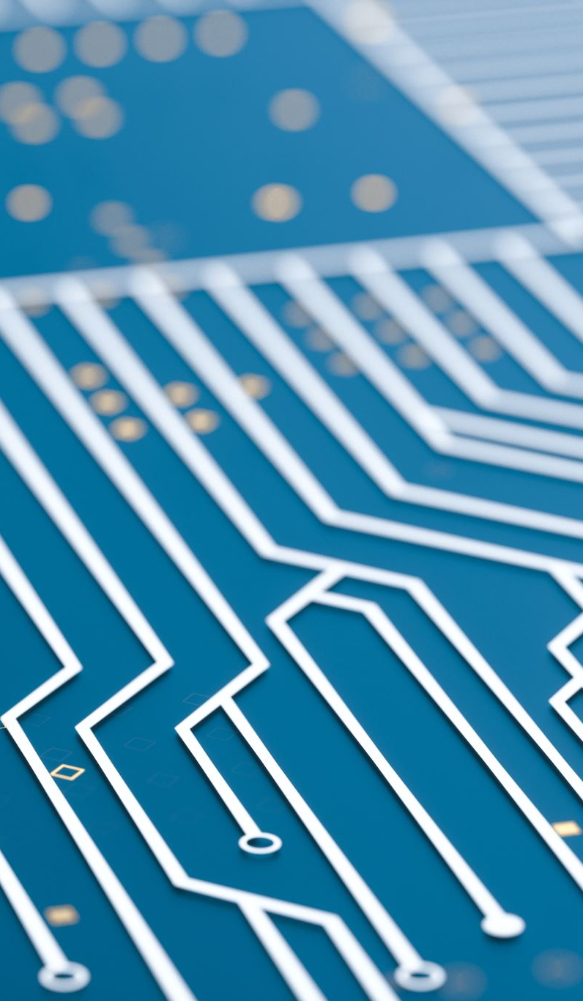
Generative Pre-Trained Transformer
GPT-1 (2018) Introduced by OpenAI
Unsupervised pre-training on large text corpora
GPT-2 (2019) Larger model with 1.5 billion parameters
Capable of generating coherent paragraphs
GPT-3 (2020) 175 billion parameters
Advanced language generation capabilities
GPT-4 (2023) 1.76 trillion parameters
GPT-4o (2024)
GPT-01 (2024)
Notes:
GPT-1 (2018)Introduced by OpenAI
Unsupervised pre-training on large text corpora
GPT-2 (2019)Larger model with 1.5 billion parameters
Capable of generating coherent paragraphs
GPT-3 (2020)175 billion parameters
Advanced language generation capabilities
ApplicationsChatbots, content creation, code generation
Future DirectionsContinual learning
Ethical considerations and bias mitigation

Slide 18

Bidirectional Encoder Representations from Transformers (BERT)
Developed by Google (2018)
Reads text in both directions for better context understanding
Self-attention mechanisms
Used by Google Search, Microsoft, Amazon Alexa and Facebook
Notes:
BERT, which stands for Bidirectional Encoder Representations from Transformers, was developed by Google AI in 2018. It has revolutionized the field of Natural Language Processing (NLP) by providing a new way to understand context in language. Unlike previous models, BERT reads text bidirectionally, meaning it considers the context from both directions rather than just left-to-right or right-to-left. This is achieved through the Transformer architecture, which utilizes self-attention mechanisms to process the input text more effectively.
BERT is pre-trained on large text corpora using two tasks: Masked Language Modeling (MLM), where some words are masked and the model learns to predict them, and Next Sentence Prediction (NSP), which helps the model understand the relationship between sentences. This pre-training allows BERT to be fine-tuned for specific tasks with smaller datasets, resulting in significant improvements in performance across various NLP tasks, including question answering, sentiment analysis, and named entity recognition.
The impact of BERT has been profound, with many companies integrating it into their AI systems. For example, Google uses BERT to improve search result relevance, Microsoft incorporates it into Bing and Office products, and Amazon leverages it for better understanding in Alexa. BERT has set a new standard in NLP, driving advancements and applications in the field.

Slide 19

What’s next?
Continual Learning: Models that learn and adapt over time from new data.
Ethical AI and Bias Mitigation: Developing fair and transparent AI systems.
Multimodal Learning: Integrating text, image, and audio data for richer understanding.
Explainable AI: Enhancing model interpretability and transparency.
Human-AI Collaboration: Improved interfaces for seamless interaction between humans and AI.
Smaller, Efficient Models: Reducing model size and computational requirements without sacrificing performance.
Notes:
As we look beyond GPT and BERT technologies, several exciting advancements and challenges are on the horizon for NLP and AI as a whole. One key area is Continual Learning, where models are capable of learning and adapting over time from new data, improving their performance and relevance without needing to be retrained from scratch.
Another crucial aspect is Ethical AI and Bias Mitigation. As AI systems become more integrated into society, it is essential to develop models that are fair, transparent, and free from biases that can lead to harmful outcomes.
Multimodal Learning is also gaining traction, focusing on integrating various types of data—such as text, images, and audio—to create models with a richer and more holistic understanding of information. This approach can lead to more sophisticated and versatile AI applications.
Explainable AI is another important trend, aiming to make AI models more interpretable and transparent. This helps build trust with users and ensures that AI decisions can be understood and scrutinized.
Human-AI Collaboration is set to improve, with better interfaces and tools that facilitate seamless interaction between humans and AI systems. This will enhance productivity and unlock new possibilities for collaborative work.
Finally, there is a growing focus on developing Smaller, Efficient Models that can deliver high performance without the heavy computational requirements of large models like GPT-3. Techniques such as model distillation and pruning are being explored to create more efficient AI systems suitable for deployment in various environments, including edge devices.
These advancements indicate a future where AI and NLP technologies become more adaptable, ethical, and integrated into our daily lives, continuing to transform how we interact with information and each other.

